Slide 1
勇行益
海 豹 突 擊 隊

Slide 2
All brands come from value
我們不只是在開創服務，
而是幫您創造出有價值的餐飲品牌!

Slide 3
我們堅持
一切努力都是為了價值
我們追求
最好的還沒生出來
我們認為
過去做的不一定是對
我們努力
貼近消費者的生活
我們相信
凡事沒有不可能

Slide 4
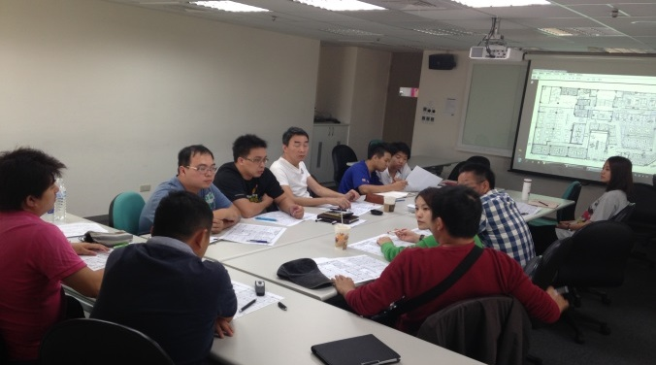
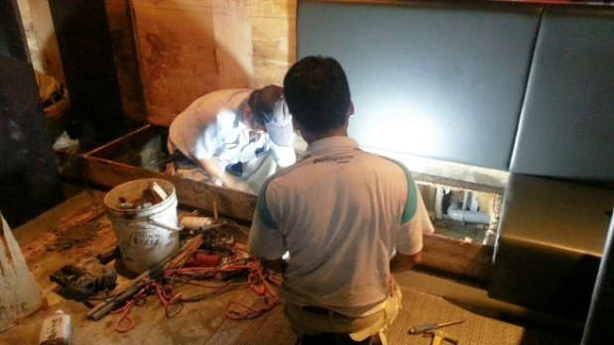
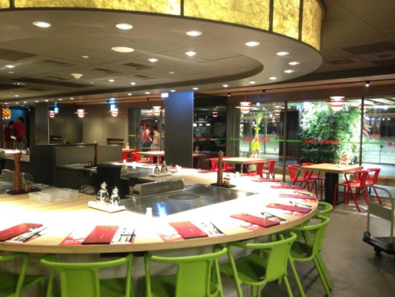
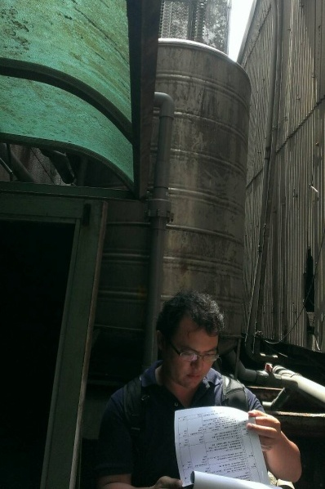
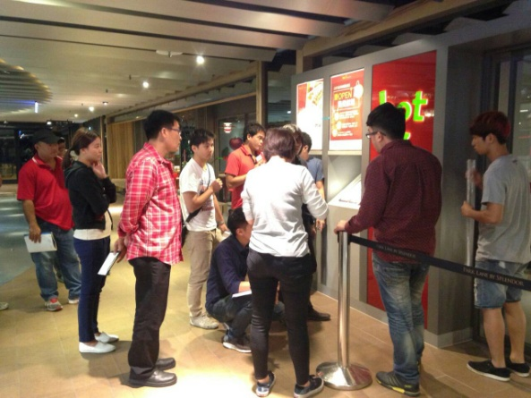
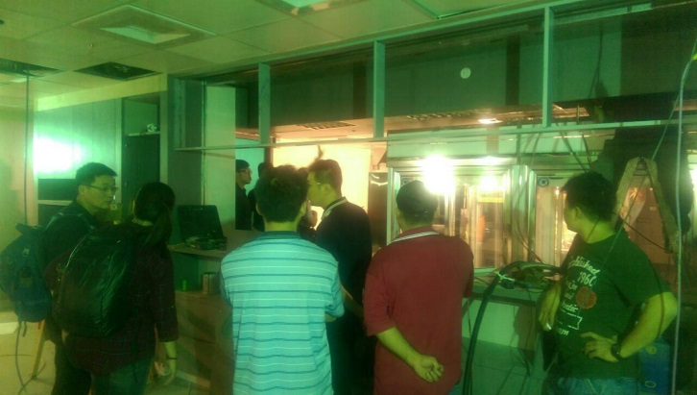
開店作業流程
新點
評估
設計
規劃
現場
說明會
工程
發包
工程
結案
工程
協調會
工程
驗收

Slide 5
Construction / Project Mgt
1
Pre-Construction
Site Condition
Sign Installation
Utilities
Drawings
Resources
Budget
Schedule
Equipment & Signage
Permits
2
Construction Contract
By Tender
By Negotiation
3
Construction
Monitoring & Control
Variations Order
Feedback & Communication
Cost Tracking
4
Restaurant Pre-Opening
Handover
Warranty Contracts & Certificates
POS
5
Post Construction
Inspection & Signed-off
Account Closing
Warranty Inspection and Signed-off
Notes:
Explain:
The standard is a process, but also a decision point.
Use the standards manual as the framework for our discussion about the site.
When the background work is done properly (MDSP, Market targeting and mapping, TZ evaluation), then finding the correct site becomes almost obvious. This happens because you have considered all the market forces at play, and they all “intersect” in only a very limited amount of the site.
This also should point out that a site decision could be disastrous without having done the background work.
Give yourself the test:
If you give someone else the same background information, would they pick the same trade zone? Would they pick the same site??
Transition to Standard 1: Reviewing the Market Plan Strategy.

Slide 6
餐廳新開店工程管理
1
工程前置作業
新址工程評估
招牌廣告位置
水電瓦斯評估申請
設計設審施工圖
廚房設計
各階段預算共識
工程時程表
水電空調設計
室裝變更申請
2
工程採購發包
工地現場說明會
工程議價
工程預決算表
傢俱設備訂購
發送管理組作合約
3
施工階段
施工圍籬輸出
工地監管
工地協調會
變更追加記錄
重點工程拍照
安全衛生管理
相關部門協調溝通
交店日期再確認
4
交店前準備工作
廚具安裝驗交
POS安裝協調
傢俱交貨確認
交店前兩天初驗
交店前徹底清潔
裝置藝術及吊燈
交店後60天結案
5
驗收交店會議
滿意度調查
14天完成缺失改善
峻工圖材料證明
第三期款簽核
60天工程結算
Notes:
Explain:
The standard is a process, but also a decision point.
Use the standards manual as the framework for our discussion about the site.
When the background work is done properly (MDSP, Market targeting and mapping, TZ evaluation), then finding the correct site becomes almost obvious. This happens because you have considered all the market forces at play, and they all “intersect” in only a very limited amount of the site.
This also should point out that a site decision could be disastrous without having done the background work.
Give yourself the test:
If you give someone else the same background information, would they pick the same trade zone? Would they pick the same site??
Transition to Standard 1: Reviewing the Market Plan Strategy.

Slide 7
工程規劃十原則
事先確定預算目標，設計之前分配預算。
合法情況先想清楚，整體評估同時解決。
安全不足一定要補，老舊症頭一次割掉。
工期是錢一定要短，營收短少就是成本。
平面佈局沒事別動，拆裝管線四倍價錢。
工法儘量拉皮就好，標準廚房順便改造。
座席坪效精打算盤，鄰店分食一併考慮。
客席分區平假午晚， 燈光空調配套開關。
發包之前完成續約，設計計價彈性有利。
動工之前溝通鄰居，圍籬安衛務必做好。
Notes:
Explain:
The standard is a process, but also a decision point.
Use the standards manual as the framework for our discussion about the site.
When the background work is done properly (MDSP, Market targeting and mapping, TZ evaluation), then finding the correct site becomes almost obvious. This happens because you have considered all the market forces at play, and they all “intersect” in only a very limited amount of the site.
This also should point out that a site decision could be disastrous without having done the background work.
Give yourself the test:
If you give someone else the same background information, would they pick the same trade zone? Would they pick the same site??
Transition to Standard 1: Reviewing the Market Plan Strategy.

Slide 8
新點評估表
Notes:
Explain:
The standard is a process, but also a decision point.
Use the standards manual as the framework for our discussion about the site.
When the background work is done properly (MDSP, Market targeting and mapping, TZ evaluation), then finding the correct site becomes almost obvious. This happens because you have considered all the market forces at play, and they all “intersect” in only a very limited amount of the site.
This also should point out that a site decision could be disastrous without having done the background work.
Give yourself the test:
If you give someone else the same background information, would they pick the same trade zone? Would they pick the same site??
Transition to Standard 1: Reviewing the Market Plan Strategy.

